Slide 1
INDIAN NATIONAL COMMITTEE
WORLD MINING CONGRESS
NATIONAL SEMINAR 2023
28th July 2023
New Delhi
MDCWL
Washing of Indian Coal for Power Sector
H.L.Sapru
CEO (Washery Business)
MDCWL LTD.

Slide 2
MDCWL
NATIONAL COAL FACT SHEET
Indian economy is likely to become the fourth largest growing economies in the world by 2027.
The growth momentum is expected to sustain for at least the next five decades.
We are aiming at production of 1.500 billion tonnes (BT) by FY 2030 and even export of Non-Coking coal.
Total estimated coal reserve of India is 361.4 BT. (Non-Coking coal - 324.65 BT & Coking coal – 35.10 BT)
70% of power generation is based on coal and is likely to remain between 60-50% in the next two decades.

Slide 3
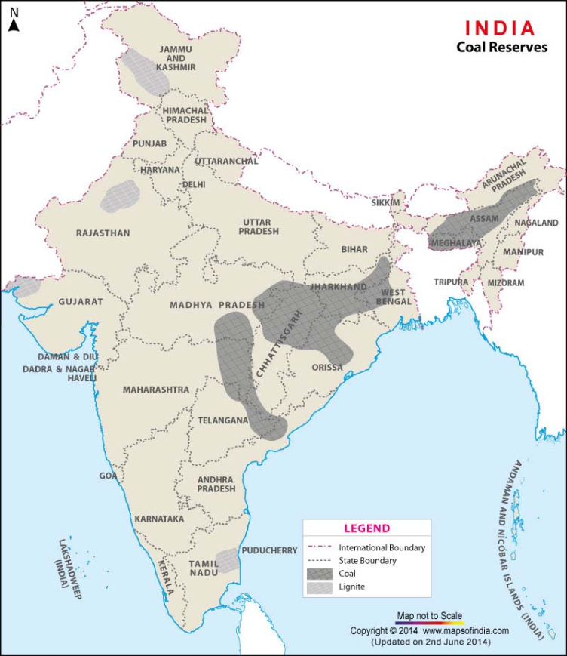
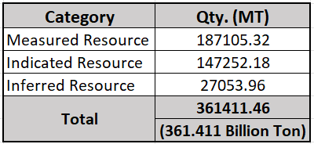
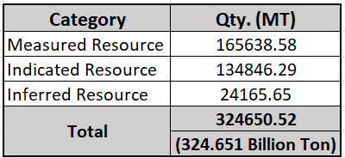
MDCWL
Coal Resources in India
Origin – Gondwana Segment (Drift Origin)
Major part in Eastern & Central part of India
Also in North Eastern States, mainly in Assam & Sikkim.
Coal Reserve in India (as on 01-04-2022)
Non-Coking Coal Reserve in India (as on 01-04-2022)
Source : Geological Survey of India

Slide 4
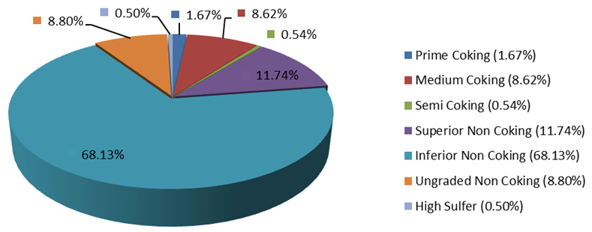
MDCWL
Type-Wise Distribution of Indian Coal
*
Source : Geological Survey of India

Slide 5
MDCWL
Characteristics of Indian Non-Coking Coal
Mainly Drift Origin
Non-Coking Coal ash content varies mostly between 34 – 55% even more. (GCV: 2500-5000 kcal/kg).
Sulphur content is below 0.5% except North-East coal resources where the same varies from 4 – 5%.
About 65% of non-coking coal belongs to high ash category. Thus, need beneficiation.
Near Gravity Material (NGM) is very High thus making it difficult to wash.
However, Technologies are available to beneficiate this ‘Difficult to Wash” coal.

Slide 6
MDCWL
Need for Washing Non-Coking Coal
To increase GCV (heat value) per unit weight and to reduce CO₂, SO_{x} and NO_{x} emission at Power Plant end.
By conservative estimates there is reduction of at least one rupee in Rs/kWh in landing cost of coal by use of Washed Coal at Power Plant end.
Reduce Capex and Opex of Power utilities and to avoid environmental problems at Power Plant.
To increase Boiler efficiency at Power Plant end.
Disposal of fly ash remains a problem though a small amount is used in manufacturing of Fly ash bricks.
To avoid misuse of Railway capacity by transporting undesired materials to Power Plant.
There is need to revisit MoEF notification for lifting restriction on transporting coal having ash more than 34% beyond 500 km/ 1000 km in the overall national interest and keeping in view the environmental concerns.

Slide 7
MDCWL
Coal Washeries in Operation in the Country:
Source:- Coal Directory of India, 2020-21, Coal Controller's Organization, Kolkata.
1. Need for expediting construction of upcoming Non-Coking Coal Washeries
10 MTPA Lakhanpur Coal Washery, IB-Valley, MCL. The largest Coal Washery of CIL.
2 x 2.5 MTPA Non-Coking Coal Washery in Sambalpur, Odisha. (Aryan Ispat & Power Private Ltd.)
2.5 MTPA Non-Coking Coal Washery, Bilaspur, Chhatisgarh. (Phill Coal Beneficiation)
2.5 MTPA Non-Coking Coal Washery, Raigarh, Chhatisgarh. (Phill Coal Beneficiation)
2. Idle washing capacity in Private Sector washeries need to be effectively utilized.

Slide 8
MDCWL
Conclusion
Coal India need to reconsider their Policies of construction of washeries on BOO (Build-Own-Operate) basis instead of BOM (Build-Operate-Maintain) basis so that Private Sector can be roped in for the purpose.
Non-Coking coal must be beneficiated and washed coal must be fed to the power plant for power generation in the overall national interest and to address environmental concerns..
Coal Beneficiation is a direct value addition to Coal Production more so when washery rejects are being sold even by Public Sector for FBC boiler. Even a trace of Coal/Carbon should be gainfully utilized.
The Trend in Power Generation is to go for Super Critical & Ultra Super Critical range for which Coal of required size and quality is a pre-requisite. So, Non-Coking coal/ Power coal need to be washed.

Slide 9
MDCWL
Thank You

